Slide 1
SMART WASTE MANAGEMENT SYSTEM FOR METROPOLITAN CITIES
PROJECT STUDENTS:
AISHWARYA B 1904065
ANUJA V 1904067
BALA DHARANI S 1904071
DHARANI K 1904073

Slide 2
OBJECTIVE
This project aims at developing an IOT based Smart waste management system for metropolitan cities.

Slide 3
NEED FOR THE PROJECT
To collect dustbins placed at public places in city.
Automatic level indication for ease of use.
Prevention from germs and diseases because it avoids the overflow condition.
Warning message indication when a Smart Trash Bin is nearly full. Also indicate location in the dashboard in the particular area.

Slide 4
EXISTING SOLUTION
Truck based waste management system, that transforms any garbage truck into a smart truck by measuring weight and capacity for each lifted can, while monitoring pickup time and location. Measure bulk waste and monitor the collection by mounting GreenQ’s system on your grapple truck. The smart grapple solution helps you gather data and turn into useful insights for your collection process.
GreenQ’s system is installed on the compactor, and can tell you when are your stationary compactors are full and when is the right time to pick them up. Stop collecting half empty containers.
Fill level sensors designed for underground containers. Sensors are activated via Narrow Band LTE, which allows for low energy consumption, minimal maintenance, and increased process efficiency.

Slide 5
LITERATURE SURVEY
S.NO | TITLE | MODEL / TECHNIQUES USED | MERITS/ DEMERITS | OUTCOMES
1. | Arindm Ghosh, Debajyoti Sarkar (2022),“Design and Fabrication of IoTbased Smart Dustbin” International Journal for Research in Applied Science & Engineering Tchnology | ARDUINO, BLUETOOTH | MERITS: Level indication enables timely pick up of wastes without overflowing | Automatic level indication and alert is sent via bluetooth to the authority(only for short range)
2. | Akshayaa S, Evangiline R (2021), “Smart bin for Clean cities using IoT”, International Conference on Advanced Computing & Communication Systems | Arduino UNO, MATLAB, BYLNK APP | MERITS Reduced level iof risk , Easy access of bins remotely | Gesture based opening and closing of garbage bin lids which prevents risk of infection

Slide 6
LITRETURE SURVEY
S.NO | TITLE | MODEL / TECHNIQUES USED | MERITS/ DEMERITS | OUTCOMES
3. | Upasana Sapra, Gayathri D (2019), “Efficient IoT based smart bin for waste management and disposal” ,Internatiosnal Journal of Informatics and Computer Science | Raspberry Pi Zero ,USB Camera module | MERITS Eco-friendly, Easy monitoring (less effort). Easy interface | . This project aims at timely pick up of wastes and easy accessing of dustbins remotely.

Slide 7
INFERENCE
The monitoring systems displays the real-time level of the garbage inside the garbage bins and the module sends SMS notification to the admin when it reaches the maximum level of the garbage's inside the garbage bin. Also there occurs some problems encountered such as no SMS notification sent to the admin.
The level detection of the garbage is done and the threshold value of the level is measured and set for the intimation of the municipalities.
Notification sending methods and protocols were inferred.

Slide 8
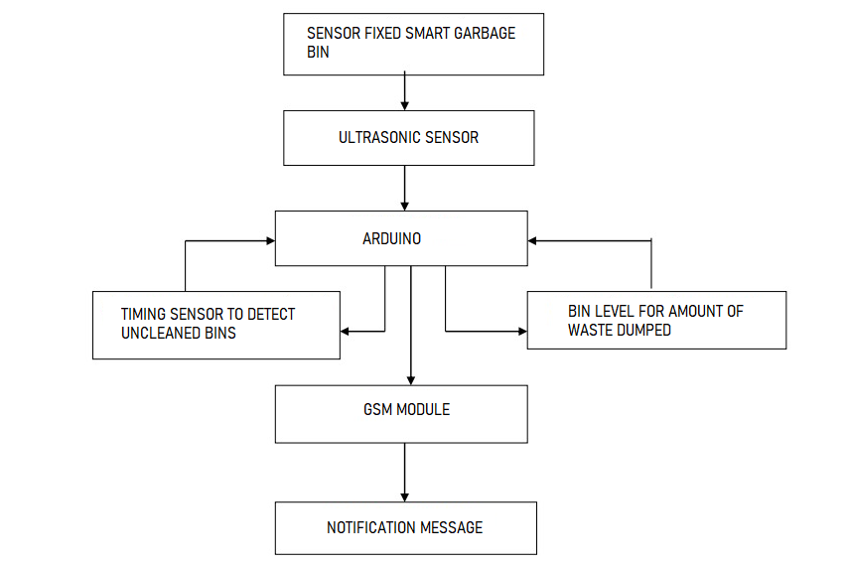
PROPOSED MODEL

Slide 9
REFERENCES
Arindm Ghosh, Debajyoti Sarkar (2022),“Design and Fabrication of IoTbased Smart Dustbin” International Journal for Research in Applied Science & Engineering Tchnology
Akshayaa S, Evangiline R (2021), “Smart bin for Clean cities using IoT”, International Conference on Advanced Computing & Communication Systems
Upasana Sapra, Gayathri D (2019), “Efficient IoT based smart bin for waste management and disposal” ,Internatiosnal Journal of Informatics and Computer Science

